Slide 1
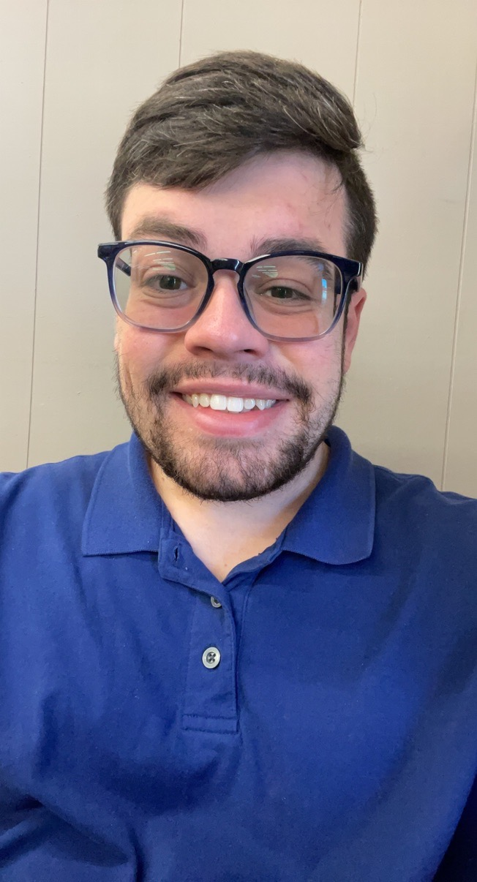
Mr. Miller
Math Intervention

Slide 2
My Contact Information
Email:
milleke@richmond.k12.ga.us
Remind:
https://www.remind.com/join/mathletesk
Website link:
https://www.rcboe.org/Domain/17041
School Number:
706-737-7288

Slide 3
Daily Schedule
Planning: 9:20-9:50am
7th Grade: 9:55-11:25am
Lunch/Planning: 11:30 -12:10pm
6th Grade: 12:15-1:45pm
Planning: 1:50-2:30pm
8th Grade: 2:35- 4:05pm

Slide 4
CHECKOUT MY WEBSITE TO VIEW THE FOLLOWING INFORMATION
Week At A Glance (WAG)
Class Syllabus/Supply List
Resources
Additional Information

Slide 5
Arrival and Dismissal
Morning Arrival
Drop off your child on Dragons Way behind the school.
Morning Drop off time for car riders 8:50 A.M.
Early drop off students are unsupervised. Please remain with your child until 8:50 A.M. when teachers report for duty.
Afternoon Dismissal
Bus riders will report to bus loading zone.
Walkers are dismissed from the bus loading zone where the crossing guard is located.
Car riders pick up time 4:05 P.M.

Slide 6
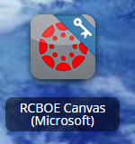
RCSS Learning Platform and Canvas
New to the Richmond County
Go to rcboe.org
Click Student
Click Launch Pad
Watch logging into Canvas as a student.
https://rcboe.instructuremedia.com/embed/048204ea-777e-4c04-9fc0-357111372c96
Your child will login through Launch Pad to access RCBOE Canvas.
Click link to watch Tutorial Video
https://www.rcboe.org/Domain/16265

Slide 7
THANK YOU FOR VISITING JOHN M. TUTT MIDDLE SCHOOL

